Slide 1


Store Sales

Slide 2
Data Cleaning
Exploratory Data Analysis

Slide 3
DATA Cleaning

Slide 4
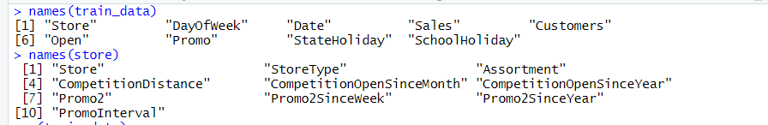
Data Cleaning
Data Set Description

Slide 5
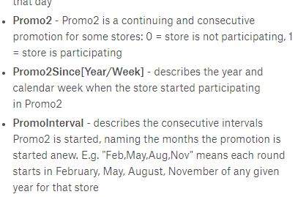
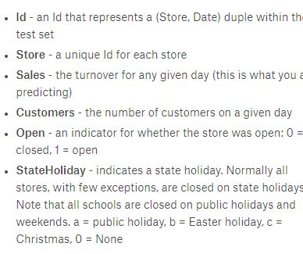
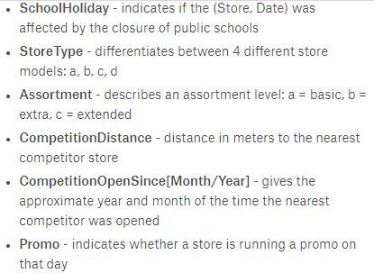

Slide 6
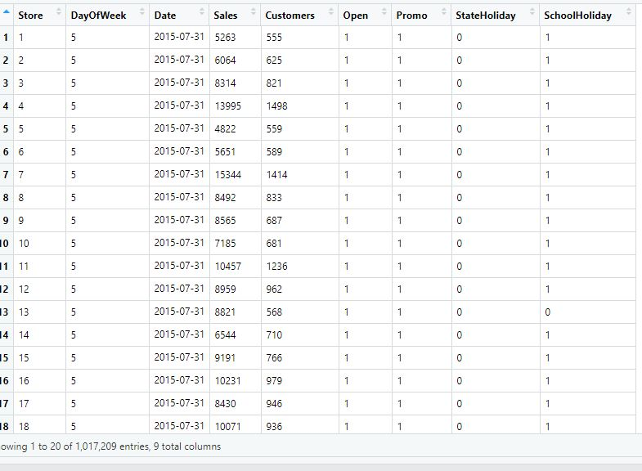

Slide 7
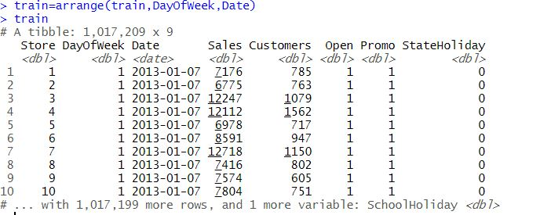
Arranging The Data Set

Slide 8
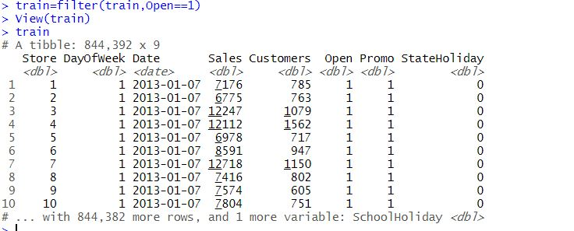
STORES WHICH WERE NOT OPEN HAVE NO ROLE In Prediction

Slide 9
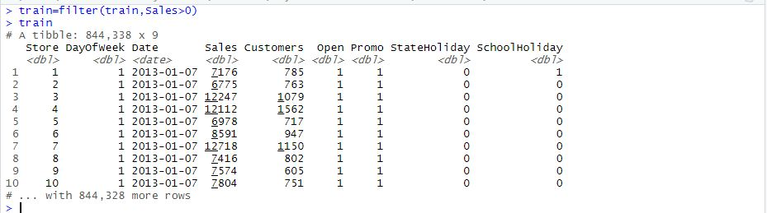
Stores Which were Open and Sales were Zero have no role in Time Series

Slide 10
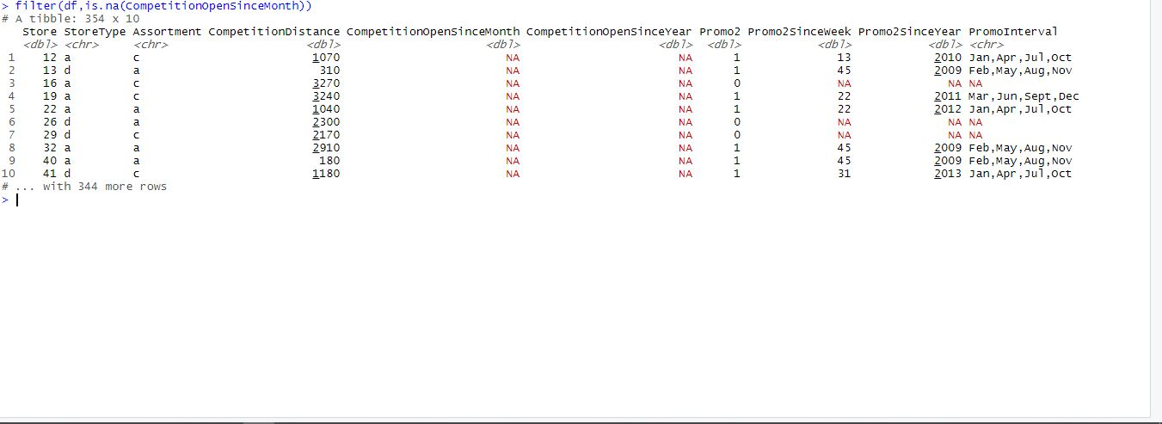
HANDLING THE NULL VALUES

Slide 11
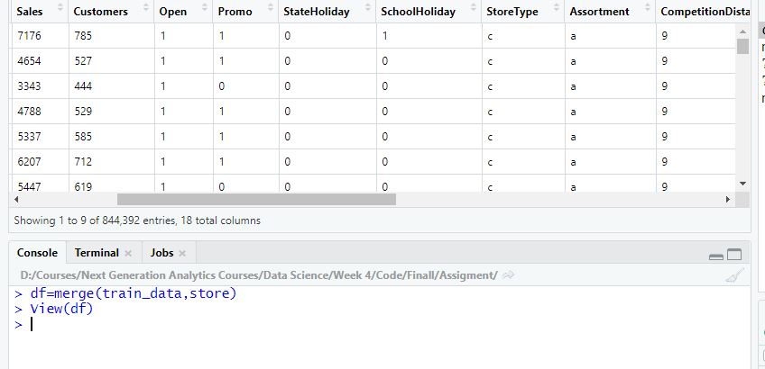
MERGING THE STORE AND TRAIN DATA SET

Slide 12
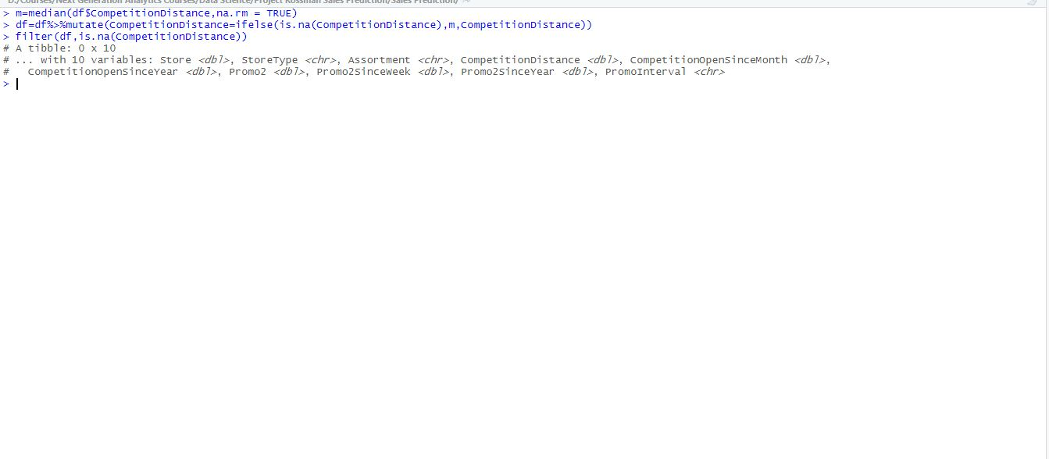
Replacing The Null values with Median of The Column

Slide 13
EXPLORARTORY DATA ANALYSIS
Note: All Data Analysis Done on Condition That The Store Should be Open Except Holiday

Slide 14
Train Set Has 1115 Stores and Each Store has 942 Days Sales…Each Store has of week sales
Test Set has 856 Stores and we have to 48 Days of Sales For Each Store

Slide 15
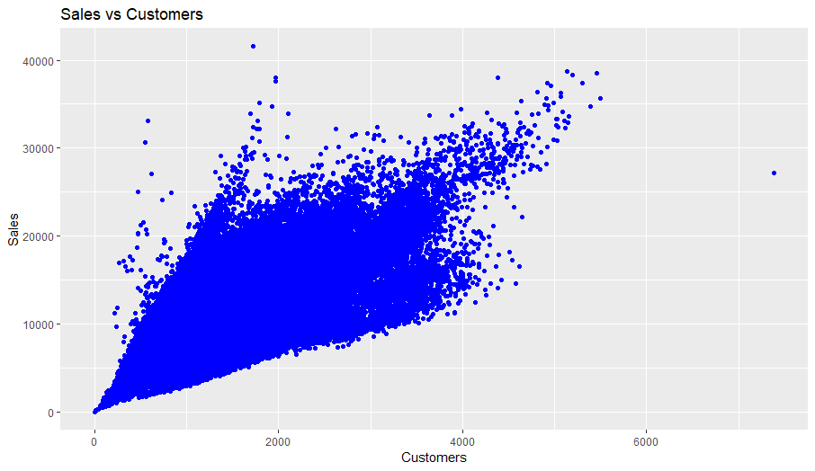

Slide 16
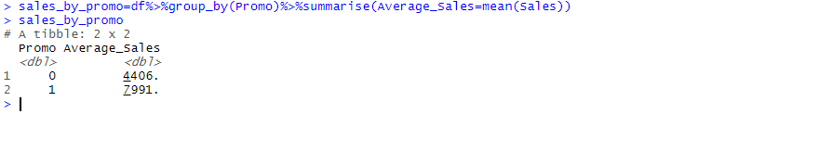
SALES BY PROMO

Slide 17
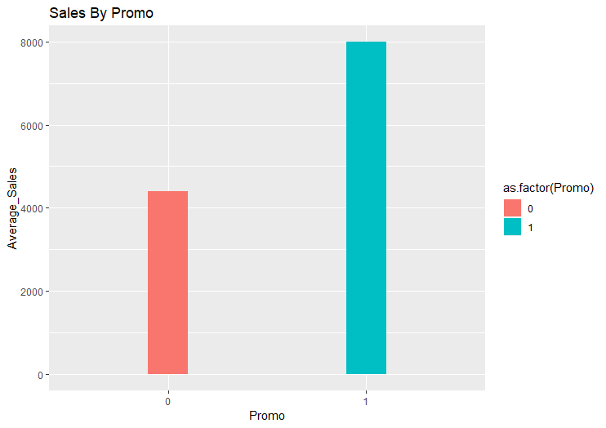

Slide 18
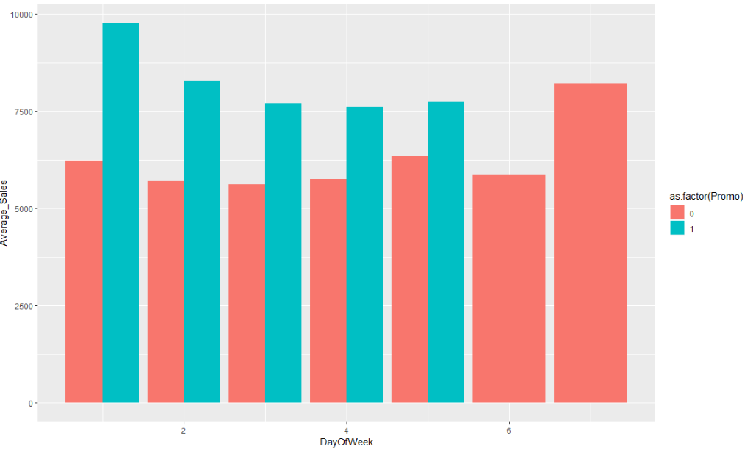

Slide 19
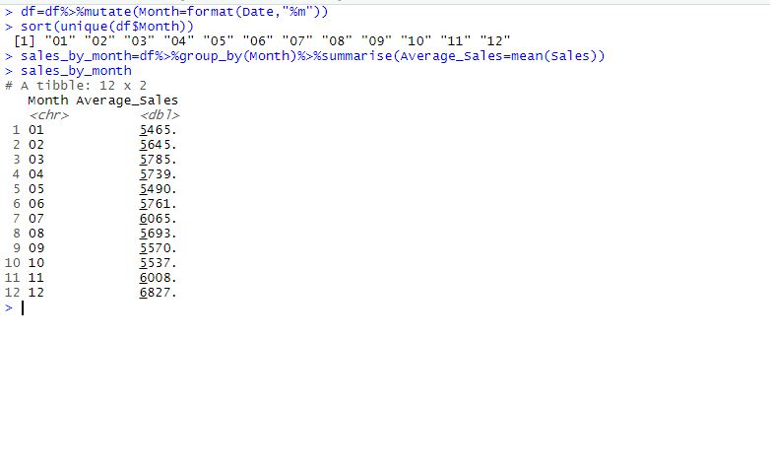
Sales With Respect Months

Slide 20
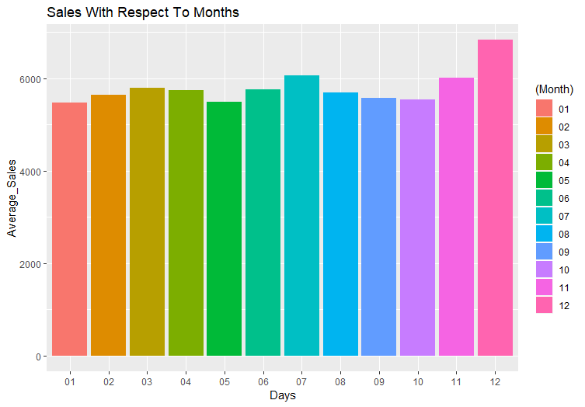

Slide 21
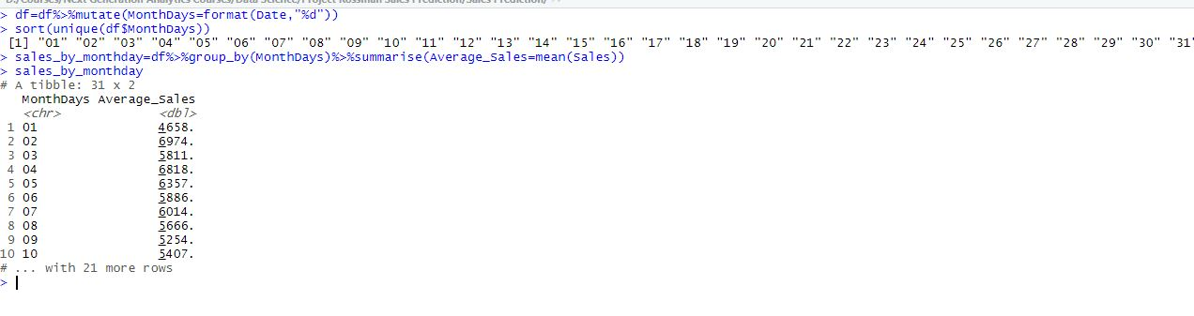
Sales With Respect To Days in Month

Slide 22
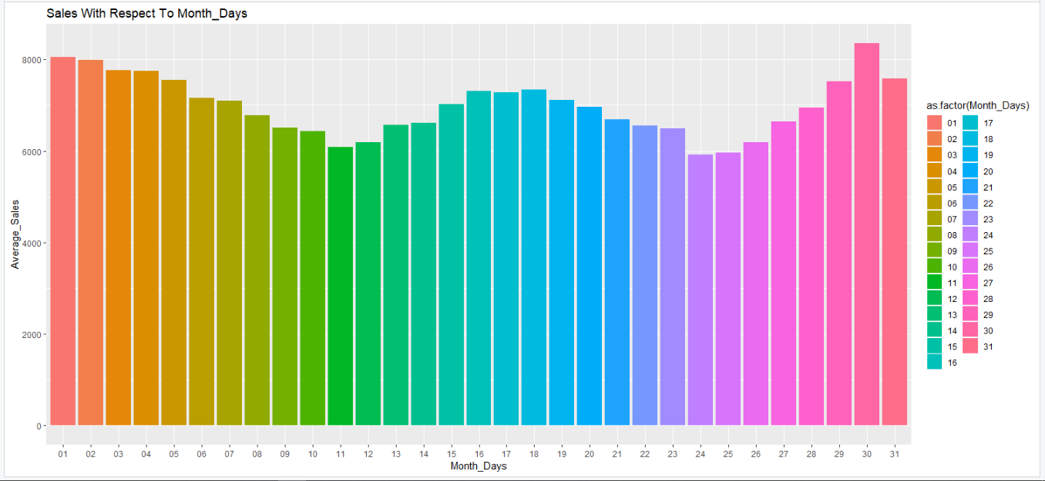

Slide 23
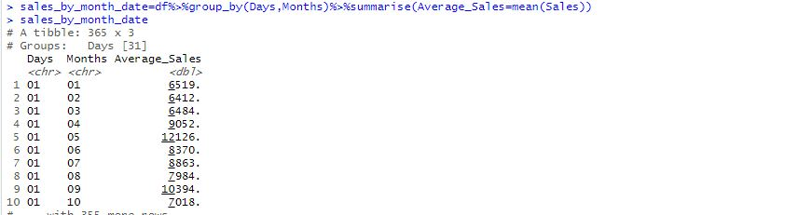
LETS SEE Months Sales in Each Day

Slide 24
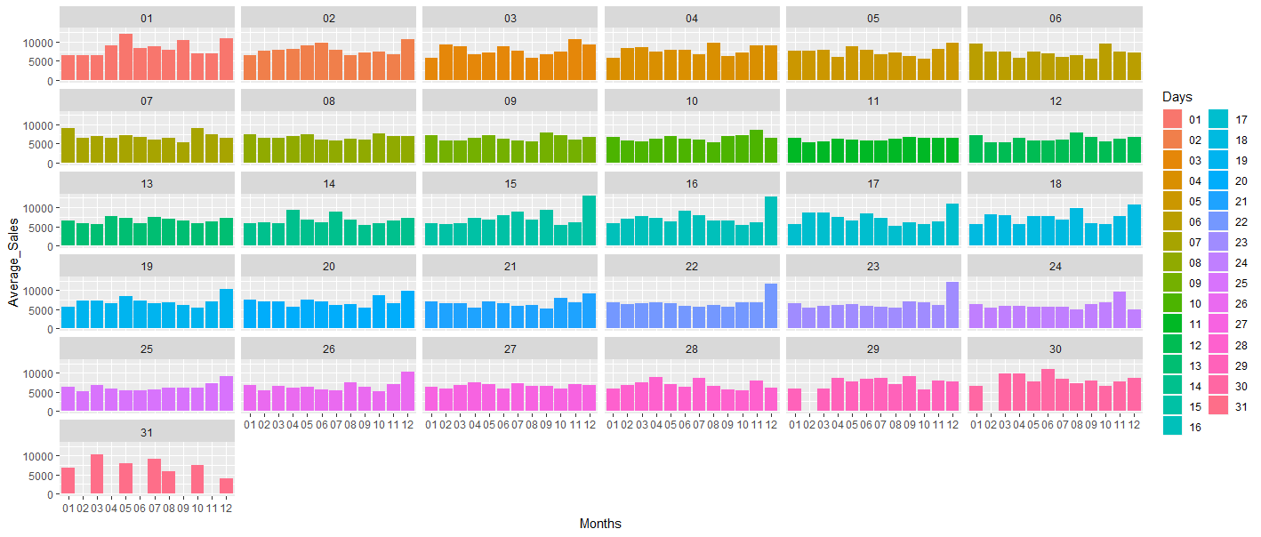

Slide 25
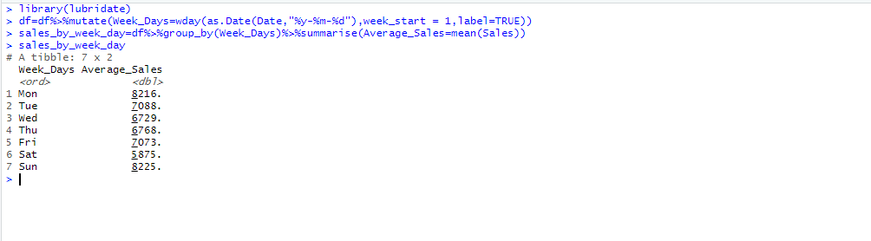
Lets See Sales On The Basis of Day Of Week

Slide 26
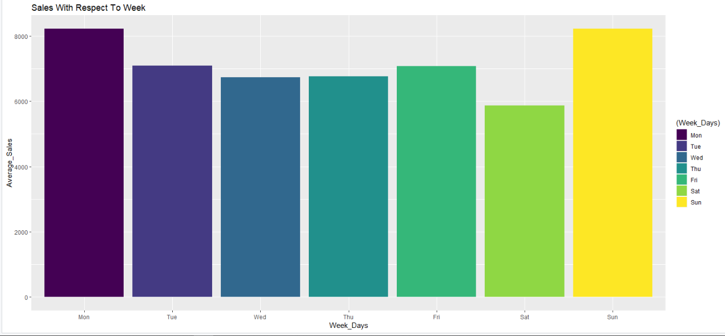

Slide 27
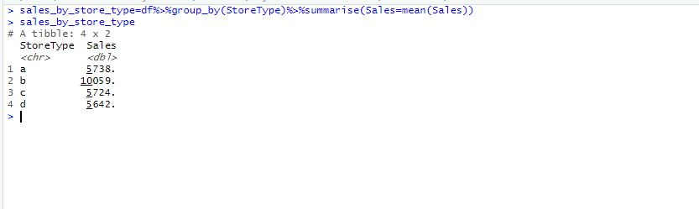
Sales By Store Type

Slide 28
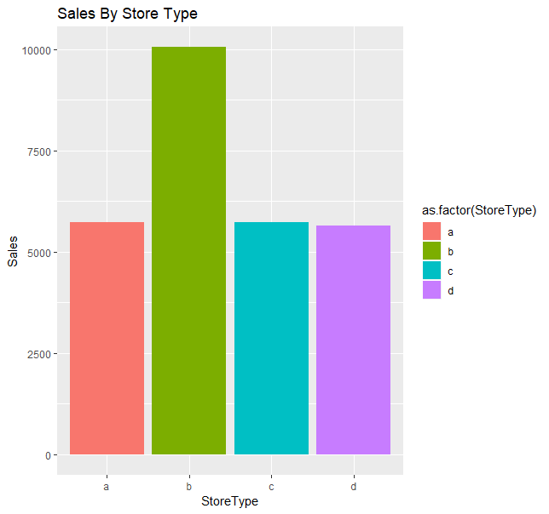
Sales By Store Type

Slide 29
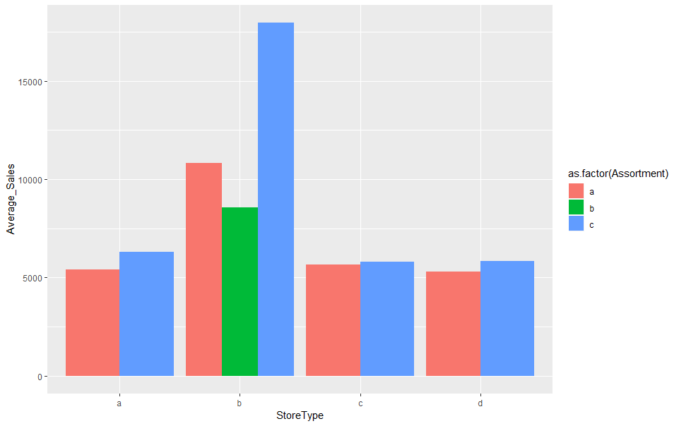
Sales By StoreType and Assortment

Slide 30
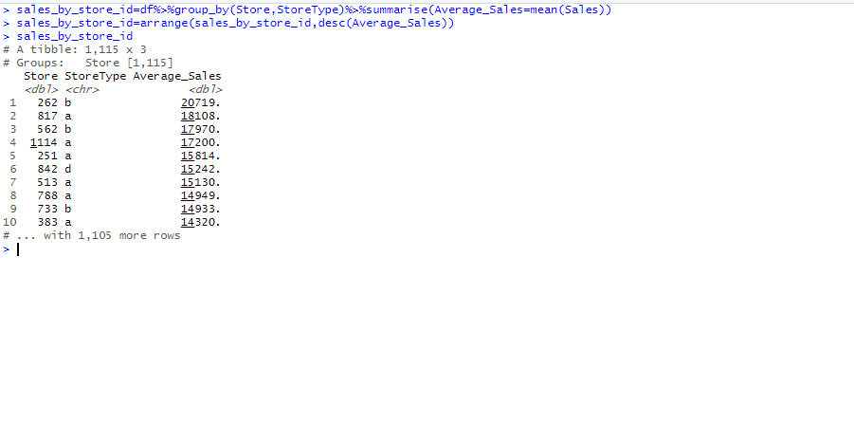
Lets See Which Store has Maximum No of Sales
Store 262 type B has Max Sales of 19516842

Slide 31
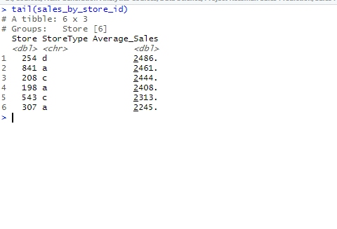
Which Store Has Minimum Sales
Store 307 having Store type has minimum Sales

Slide 32
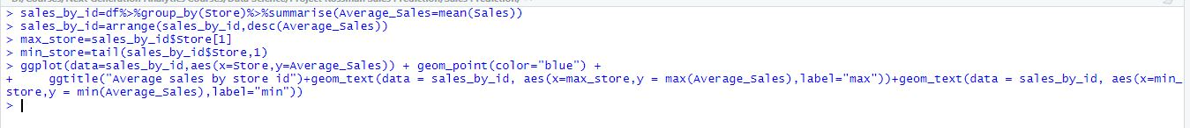
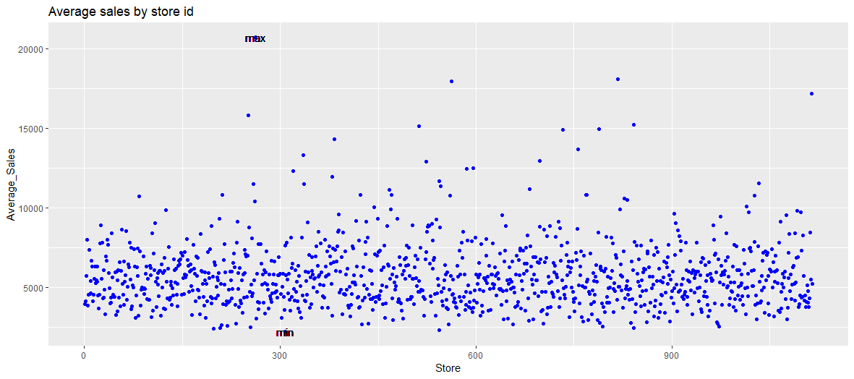
LETS VISUALIZE IT

Slide 33
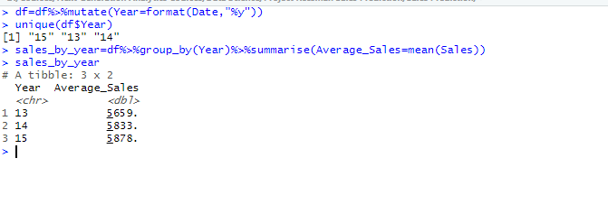
Sales By Year

Slide 34
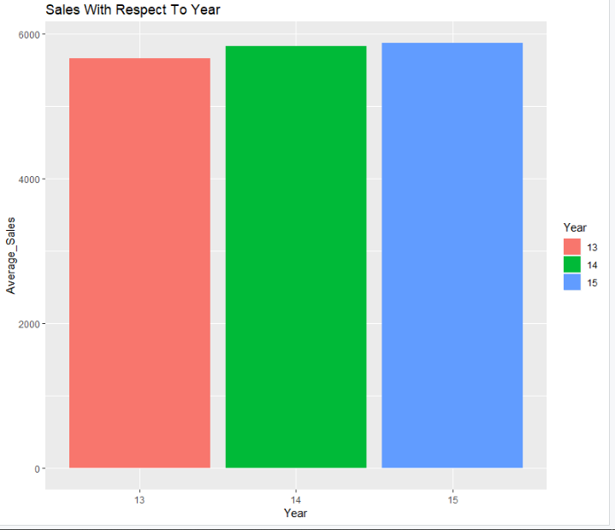

Slide 35
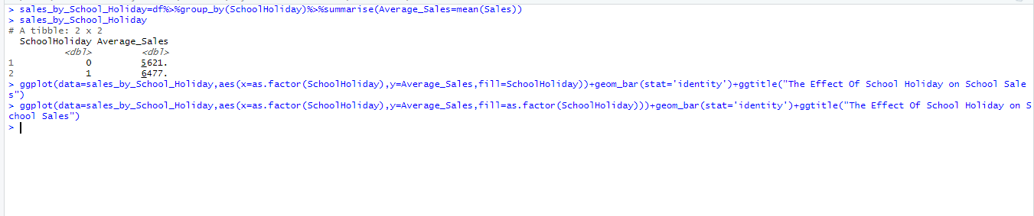
Sales With Respect To School Holiday

Slide 36
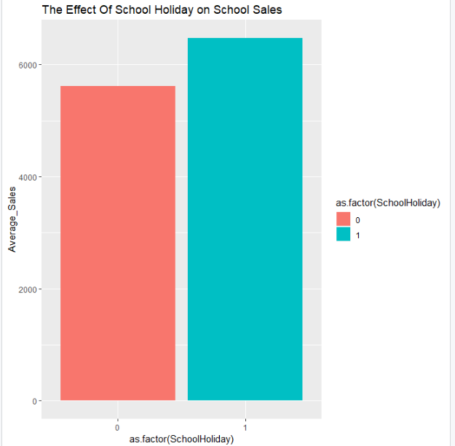

Slide 37
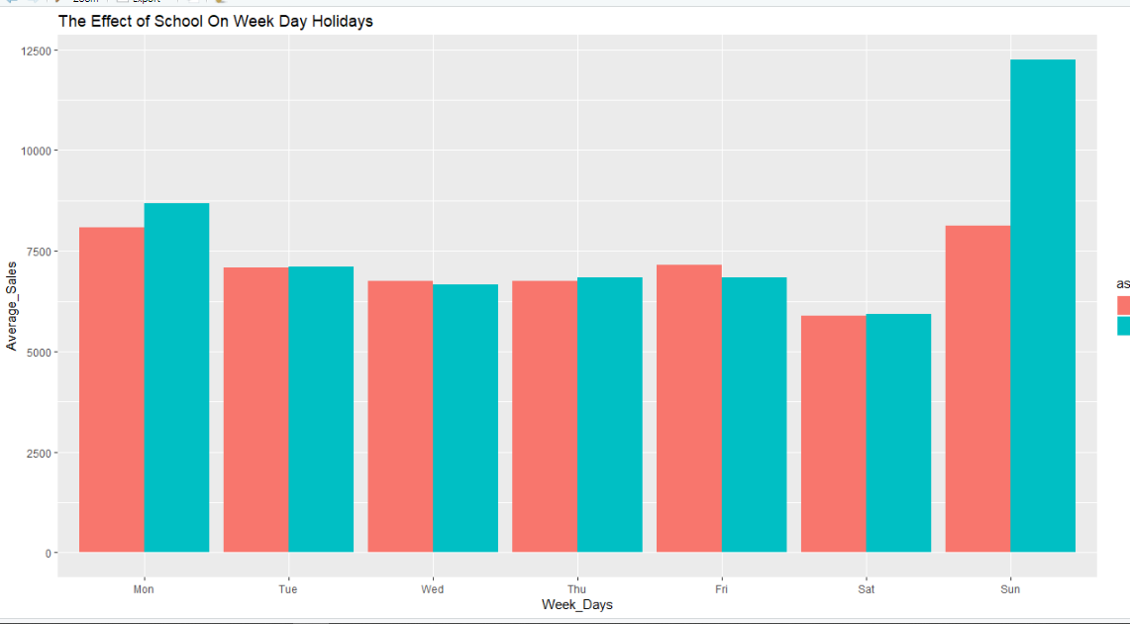
Week Days and School Holiday

Slide 38
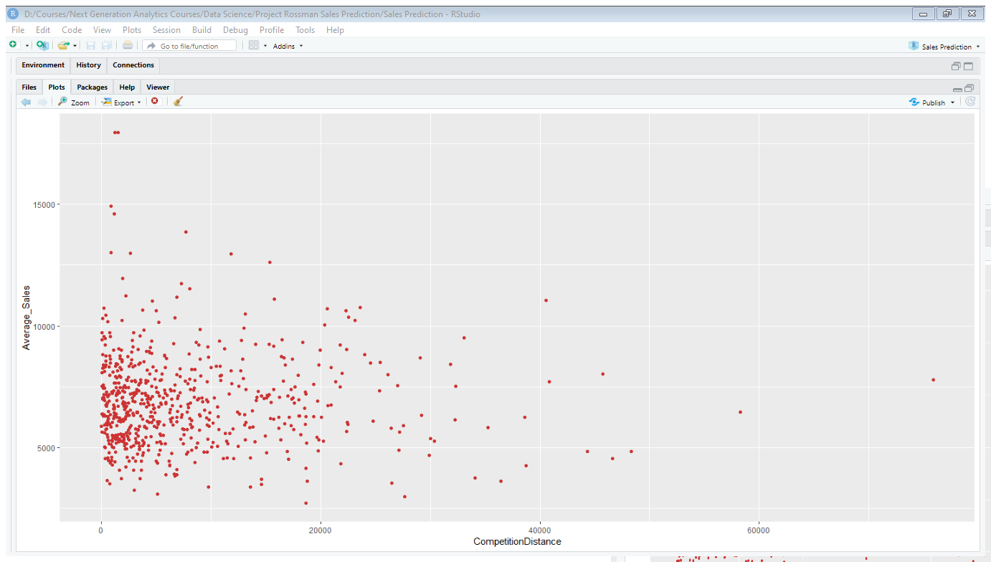

Slide 39
Conclusion Of EDA
The Feature Customer have Strong Correlation With Sales and Promo has the Normal Correlation With Sales
The Average Sales Increases When There is a Promo On The Store
The Sales Of Month December are greater than All other Months
The Sales Increases in December Because of The Event of New Year and Christmas’s
The Average Sales are greater in The Beginning and End of The Month

Slide 40
Conclusion Of EDA
Because of The Month End The Sales Increases In The Store
The Sunday and Monday has the Highest Average Sales as Compared To Other Days
The Sunday has the Highest Sales because of School Holiday
The Store Type b has The Maximum Average Sales
The Assortment Of Type C has highest Average Sales In Store B
There is not Too much effect of School Holiday on Other Days except Sunday. As Sunday is already a holiday

Slide 41
Conclusion Of EDA
Increase In Competition Distance Decrease The Average Sales
Store 262 has Maximum Sales Having Store Type B
Store 367 has Minimum Sales Having Store Type A
The Sales has Increased In Year 14 and 15 as compared to 13

